Slide 1

DS-3002: Data Systems
An Overview of SQL Databases

Slide 2
SQL Database Design
Understanding the Principles that Govern Database Structure

Slide 3
Fundamental Structures: Enforcing Data Integrity
Essential Design Concepts & Database Objects Required for Enforcing Data Integrity
Entity Integrity
Enforced by the Table
Entities (nouns):
Concrete: Employees, Customers, Products
Domain Integrity
Enforced by the Column
Data Type definition:
Constraints:
Relational Integrity
Enforced by the Foreign Key Relationship
One-to-Many: Foreign key relates to Primary key
Many-to-Many: Primary keys relate to Foreign keys via a Juncture table
Int, Decimal, Float, Char, Nchar, Varchar, Nvarchar, DateTime
Primary Key, Check, Unique, & Default
People, Places and Things
Conceptual: Sales, Scenarios, etc.

Slide 4
Database Normalization: The Normal Forms
There are other Normal Forms, but Resolving to 3rd NF is Considered Appropriate
First Normal Form (1NF)
A tables columns must contain only atomic values; none may not contain multiple values
Ex: a column named telephone_number may contain only one phone number.
Second Normal Form (2NF)
The table must first satisfy the first normal form.
The table must be free of partial dependencies; i.e., all columns that are not the Primary Key must depend on the Primary Key
Third Normal Form (3NF)
The table must first satisfy both the first and second normal forms
The table must be free of transitive dependencies; i.e., no column may depend on any column that is not the Primary Key.
Notes:
Transitive dependency: It occurs due to an indirect relationship within the attributes when a non-prime attribute has a functional dependency on a prime attribute.

Slide 5
Workload Characteristics: Form Follows Function
Two Essentially Incompatible Workloads… They Have a Contentious Relationship
Online Transaction Processing (OLTP)
Characterized by a large volume of transactions each of which affect a small number of rows
Online Sales, Bank Deposits & Transfers
Highly Normalized Database Schema
Online Analytical Processing (OLAP)
Characterized by a small volume of read transactions each of which affect a large number of rows
Periodic Post-hoc Analysis (What Happened?)
De-Normalized Multi-Dimensional Schema
!
These two don’t play well together: They contend for the same hardware resources!

Slide 6
Database Paradigms: Design Approaches
The Design Approach Accommodates the Workload Characteristic
Normalized Relational Database:
Optimized for Online Transaction Processing (OLTP) workloads
Aims to Eliminate Data Redundancy and Minimize Storage Requirements
Complex: Sacrifices User-Friendliness in Favor of Transactional Performance
Multi-Dimensional Relational Database:
Optimized for Online Analytical Processing (OLAP) workloads
Aims to Optimize Query Performance and Provide an Intuitive User Experience
Simple: Accepts Data Repetition in Favor of User-Friendliness and Improved Query Performance

Slide 7
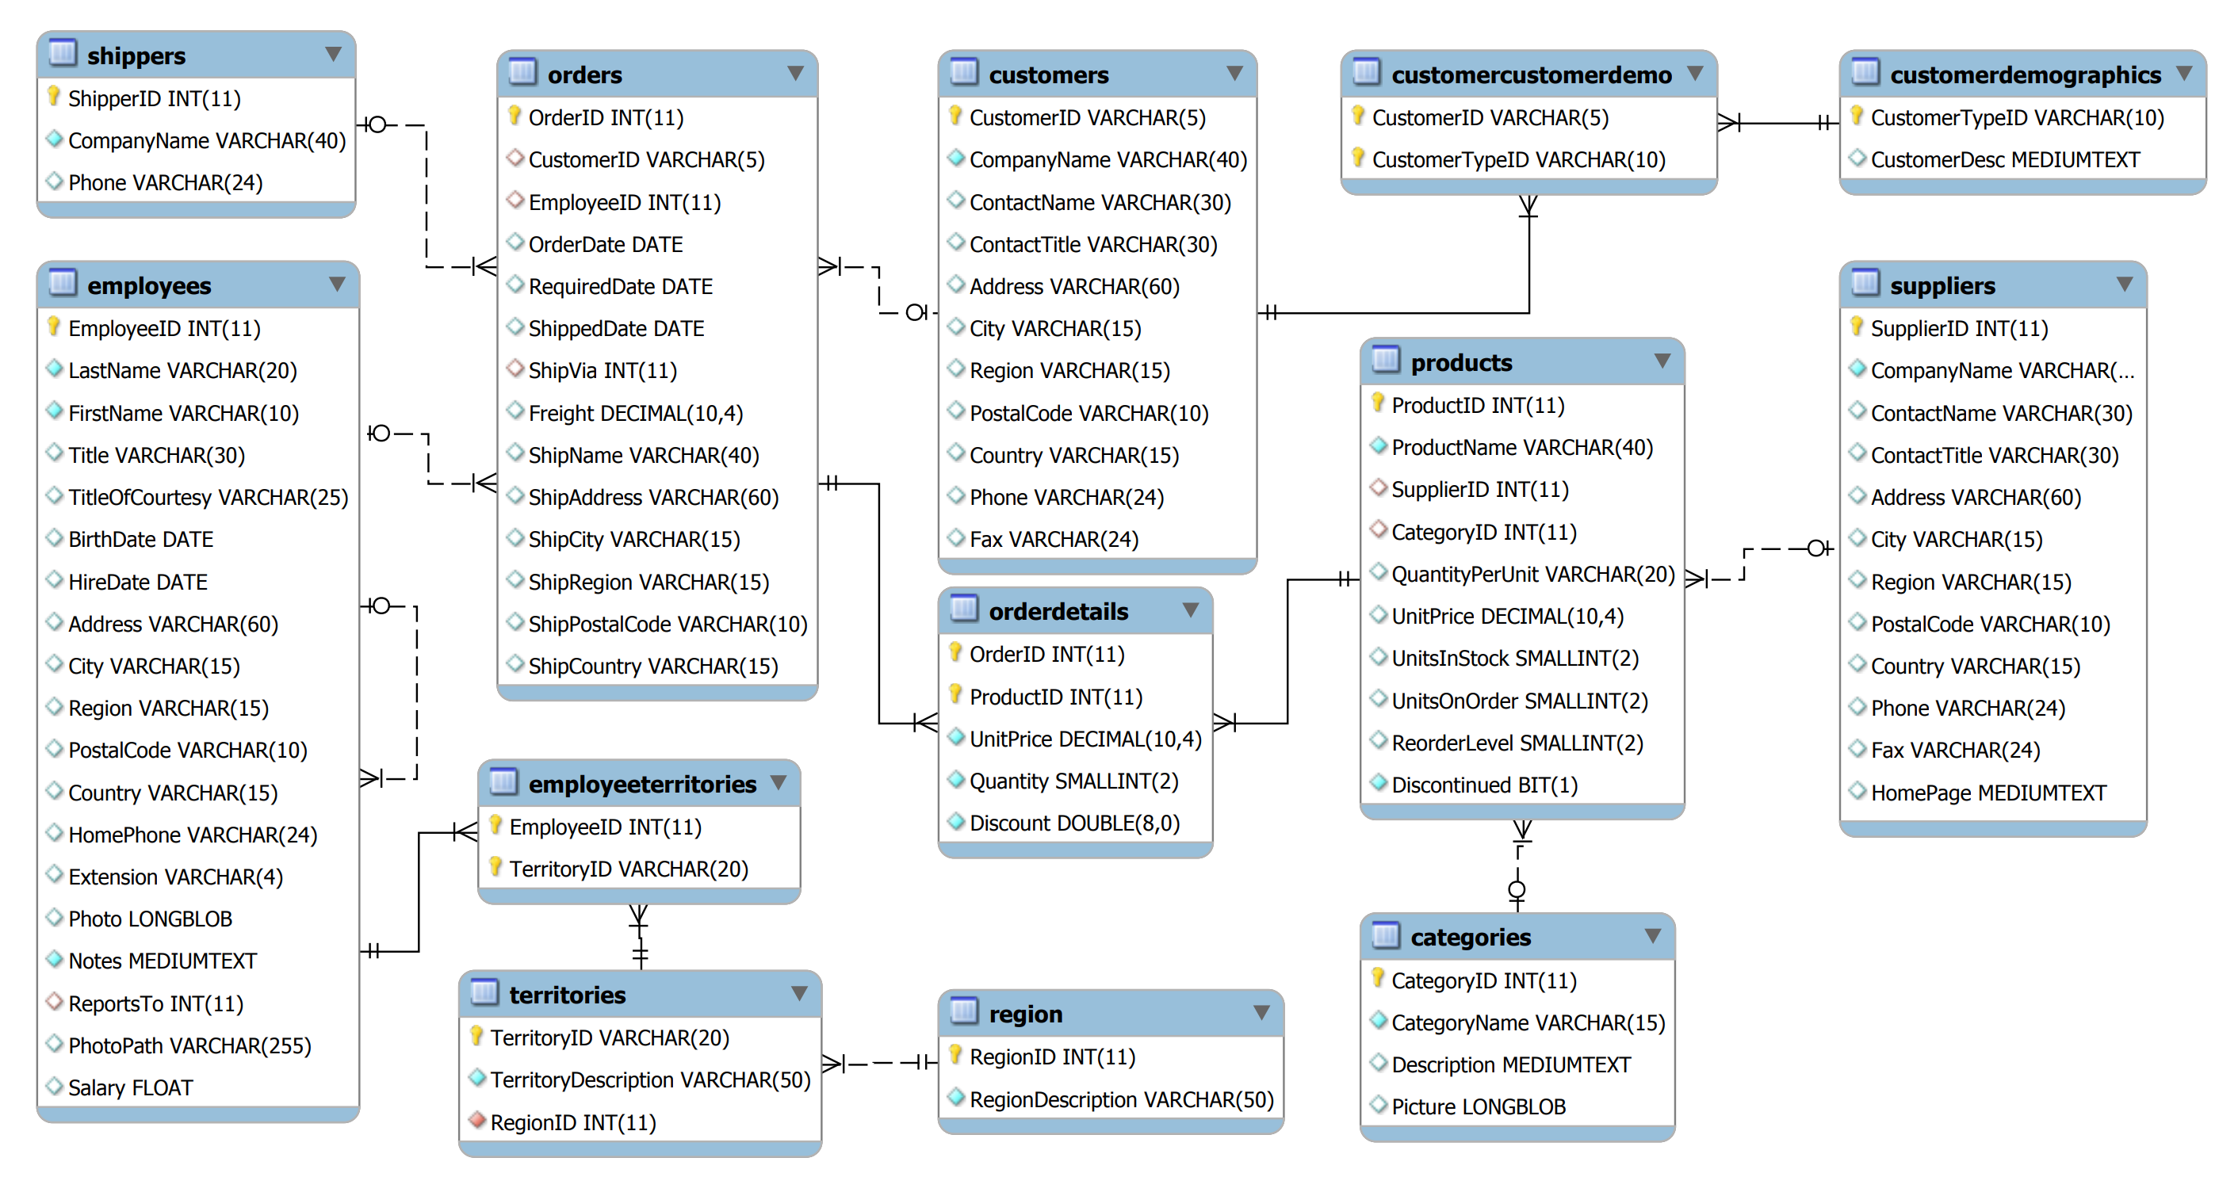
OLTP Database: Normalized Schema

Slide 8
The SQL Language
Understanding the Structured Query Language

Slide 9
The SQL Language: Principal Components
Three Primary Aspects of the ANSI-Compliant SQL Language
Data Definition Language (DDL)
CREATE, ALTER, DROP, TRUNCATE TABLE, ENABLE & DISABLE TRIGGER
Used to manage database structures
Data Control Language (DCL)
GRANT, REVOKE, DENY, EXECUTE AS
Used to control access to server & database objects (permissions)
Data Manipulation Language (DML)
SELECT, INSERT, UPDATE, DELETE, MERGE, and BULK INSERT
Used to manipulate database content (data)
Microsoft Docs | Transact-SQL Reference (Database Engine)

Slide 10
Query a SQL Database: The SELECT Statement
Essential Components of Data Retrieval
SELECT
for specifying the required columns
FROM
for specifying the Table(s) being targeted
JOIN
for specifying additional Table(s)
GROUP BY
for specifying points of aggregation
ORDER BY
for sorting rows of the result set
Filtering Statements:
ON
specifies the column(s) that enable the joining of two Tables
WHERE
specifies conditions by which to reduce the rows returned
HAVING
specifies conditions by which Groups or Aggregates may be reduced

Slide 11
SQL
Structured Query Language
Database language used to manage and query relational databases
A well-known, commonly used standard
Regularly updated
Many extensions, variations
Platform-specific versions, etc.

Slide 12
Generations of Programming Languages
1st generation
Machine code
2nd generation
Human-readable but directly related to processor
Assembly language, C (sort of)
3rd generation
Abstraction from processor, easier for humans
Fortran, C/C++, Java, etc.
4th generation
Programming Language for specific task
e.g. SQL, Matlab
5th generation
Give constraints (goal), and result follows logically
e.g. Prolog

Slide 13
SQL Elements
Data Definition Language (DDL)
Supports creation of database schema
Data Manipulation Language (DML)
Supports entering/removing data
Querying Language
Supports query operations (don’t change data itself)
Others:
Transaction control, Data control

Slide 14
Our Discussion of SQL
Will highlight some of the structures and features of SQL
Give you an idea of the basics of how it works
Reflects how relational databases work
Not meant to make you SQL programmers
You will need to implement equivalent functions for parts of what we discuss

Slide 15
Database Schema
The set of relations (tables) in the database.
Create, delete, change tables

Slide 16
CREATE
Define a relation
CREATE TABLE <name> (
<element list>
);
element = <name> <type>

Slide 17
Element Types
INT, INTEGER
Integers
FLOAT, REAL
Floating-Point numbers
CHAR(n)
Fixed-length string of n characters
VARCHAR(n)
Variable-length string of up to n characters
DATE
yyyy-mm-dd
TIME
hh:mm:ss

Slide 18
Example
CREATE TABLE HouseRep (
Name VARCHAR(80),
Party CHAR(10),
Birthdate DATE,
YearsInCongress INT,
Salary REAL
);

Slide 19
Declaring Keys
Keys declared within CREATE statement
Key attributes functionally determine all other attributes in the relation
List under PRIMARY KEY
Elements of primary key can not be NULL

Slide 20
Example
CREATE TABLE HouseRep (
Name VARCHAR(80),
Party CHAR(10),
Birthdate DATE,
YearsInCongress INT,
Salary REAL,
PRIMARY KEY (Name)
);

Slide 21
Example
CREATE TABLE HouseRep (
Name VARCHAR(80),
Party CHAR(10),
Birthdate DATE,
YearsInCongress INT,
Salary REAL,
PRIMARY KEY (Name, Birthdate)
);

Slide 22
Other Element Modifiers
UNIQUE
Placed after type
Only one tuple in that relation for each value (except NULL)
Can imply key if no primary key given
Can be NULL
NOT NULL
Cannot take value NULL
DEFAULT
Default value specified

Slide 23
Example
CREATE TABLE HouseRep (
Name VARCHAR(80) UNIQUE,
Party CHAR(10),
Birthdate DATE NOT NULL,
YearsInCongress INT
DEFAULT 0,
Salary REAL
DEFAULT 120000.00
);

Slide 24
Other Table Modifications
DROP <name>
Deletes that table
ALTER TABLE <name> ADD <attribute>
Adds a new column to table
ALTER TABLE <name> DROP <attribute>
Removes the column from the table

Slide 25
Other Table Modifications
DROP <name>
Deletes that table
ALTER TABLE <name> ADD <attribute>
Adds a new column to table
ALTER TABLE <name> DROP <attribute>
Removes the column from the table

Slide 26
Views
Views are a sort of “virtual table”, usually created as the result of a query
We’ll discuss queries soon
Format:
CREATE VIEW <name> AS <query>

Slide 27
Modifying the Database
Data Manipulation Language
Given a schema, must “populate” the database with actual data
Insert, Delete, Modify

Slide 28
Insertion
INSERT command:
INSERT INTO <Relation>
VALUES (<value list>);
Can specify only certain attributes in Relation
Relation(<attribute list>)
Instead of values, can have subquery

Slide 29
Insertion Example
Senator(Name,Party,State,Years)
INSERT INTO Senator
VALUES (Jill Smith, Republican, NY, 5);
INSERT INTO Senator(Name, State)
VALUES (Jill Smith, NY);

Slide 30
Deletion
Delete from relation according to condition
DELETE FROM <Relation>
WHERE <condition>;
Example: delete Texas Senators:
DELETE FROM Senator
WHERE State = ‘TX’;

Slide 31
Modification
Update subset according to condition
UPDATE <Relation>
SET <list of attribute assignments>
WHERE <condition>;
Example: Joe Lieberman becomes Independent
UPDATE Senator
SET Party = ‘Independent’
WHERE Name = ‘Joseph Lieberman’;

Slide 32
Q & A
A Survey of Data Management Systems

